Slide 1
EDA CASE STUDY
Consumer Loans
By: Preeti Rawat and Yasaswini Sampathkumar

Slide 2
Problem Statement: Risk Analytics in BFSI
This case study aims to identify patterns which indicate if an applicant has difficulty in paying his/her installments which may be used for taking actions such as denying the loan, reducing the amount of loan, lending (to risky applicants) at a higher interest rate, etc. This will ensure that the consumers capable of repaying the loan are not rejected and the number of defaulters is also reduced.
Data Set used:
1. 'application_data.csv' contains all the information of the client at the time of application. The data is about whether a client has payment difficulties.
2. 'previous_application.csv' contains information about the client’s previous loan data. It contains the data whether the previous application had been Approved, Cancelled, Refused or Unused offer.

Slide 3
1. Categorical Univariate Analysis for Target 0 i.e. people with no payment difficulty

Slide 4
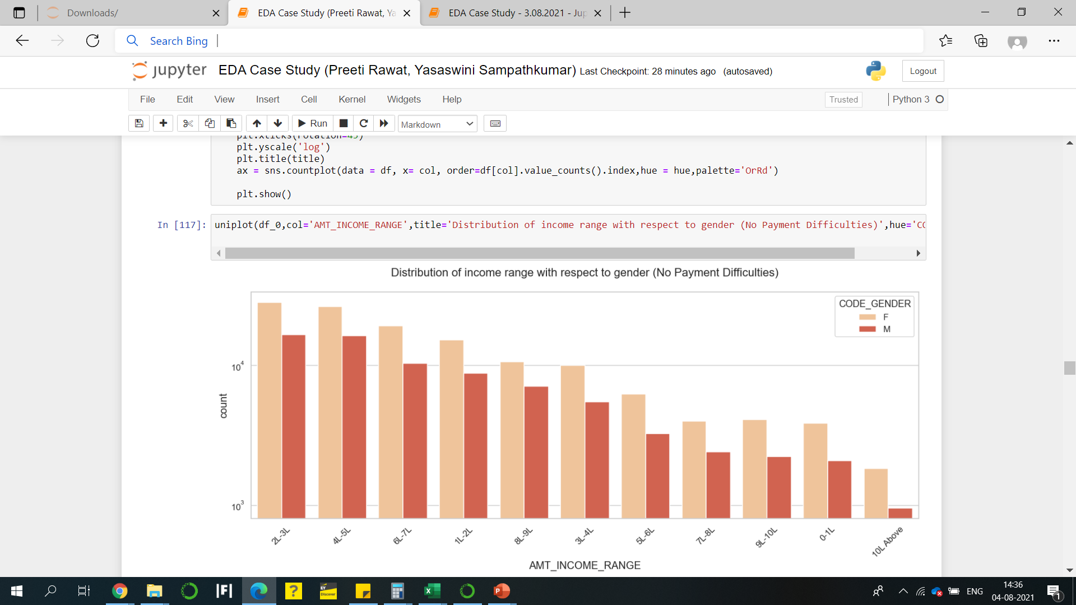
Distribution of Income range with respect to gender (T0)
Inference from the graph on right:
Across all income ranges, female count is higher than male.
Income range from 2 lakh -3 lakh is having more number of credits.
Very less count for income range 10 lakh above.

Slide 5
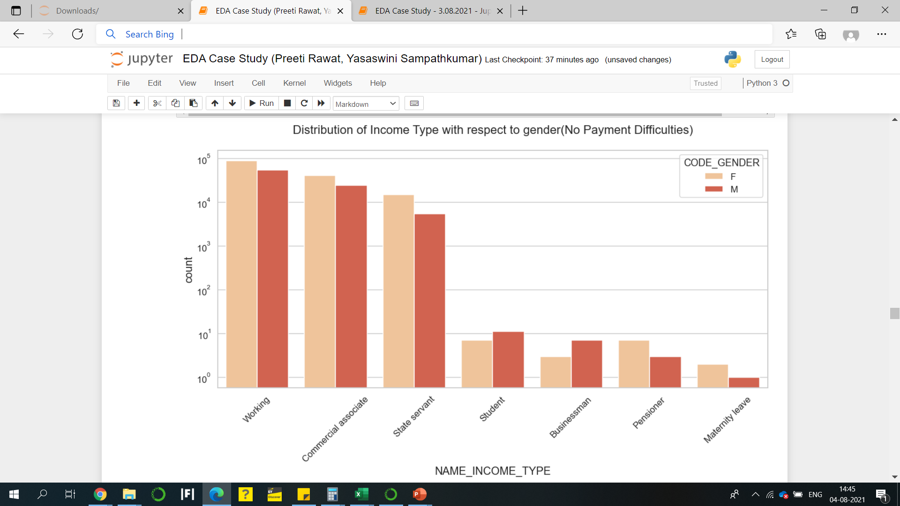
Distribution of Income Type with respect to gender (T0)
Inference from the graph on right:
For income type ‘working’, ‘commercial associate’, 'Pensioner', ‘State Servant’, 'Unemployed', 'Maternity leave’, females have a higher count.
For income type ‘student’ , ‘Businessman’ - males have a higher count.

Slide 6
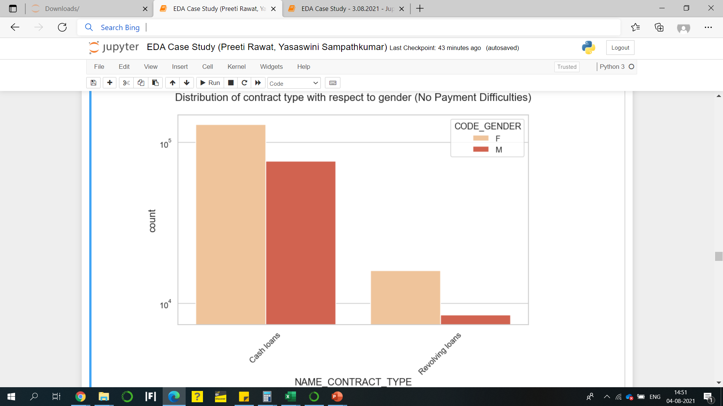
Distribution of Contract Type with respect to gender (T0)
For contract type, ‘cash loans’ have higher count than ‘Revolving loans’ contract type
For both type of contracts, females have a higher count when it comes to repayment.

Slide 7
2. Categorical Univariate Analysis for Target 1 i.e. people with payment difficulty

Slide 8
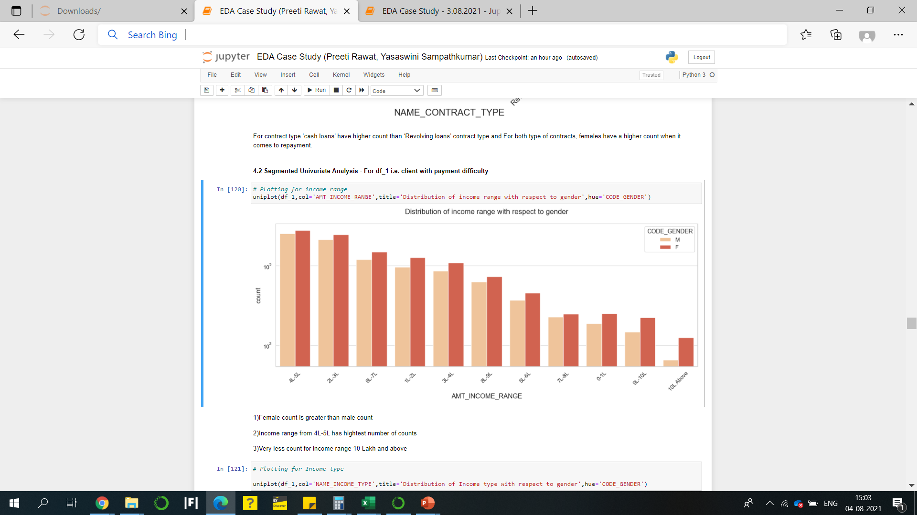
Distribution of Income range with respect to gender (T1)
Inference from the graph on right:
Across all income ranges, female count is higher than male.
Income range from 4 lakh -5 lakh is having more number of credits.
Very less count for income range 10 lakh above.

Slide 9
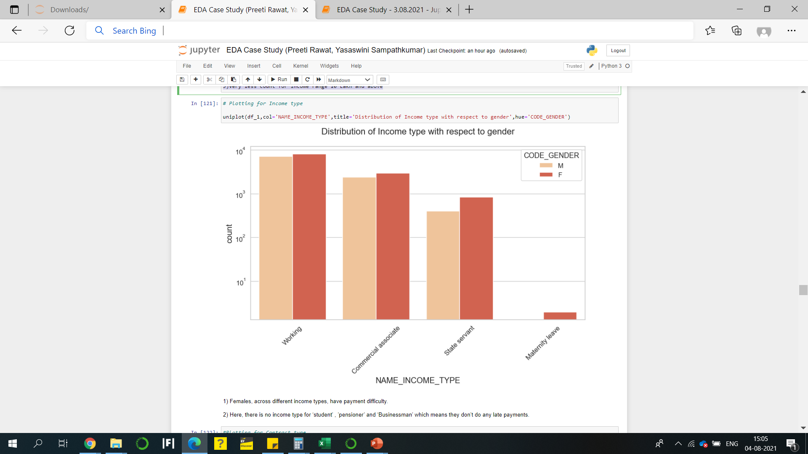
Distribution of Income Type with respect to gender (T1)
Inference from the graph on right:
Females, across different income types, have payment difficulty.
Here, there is no income type for ‘student’ , ’pensioner’ and ‘Businessman’ which means they don’t do any late payments.

Slide 10
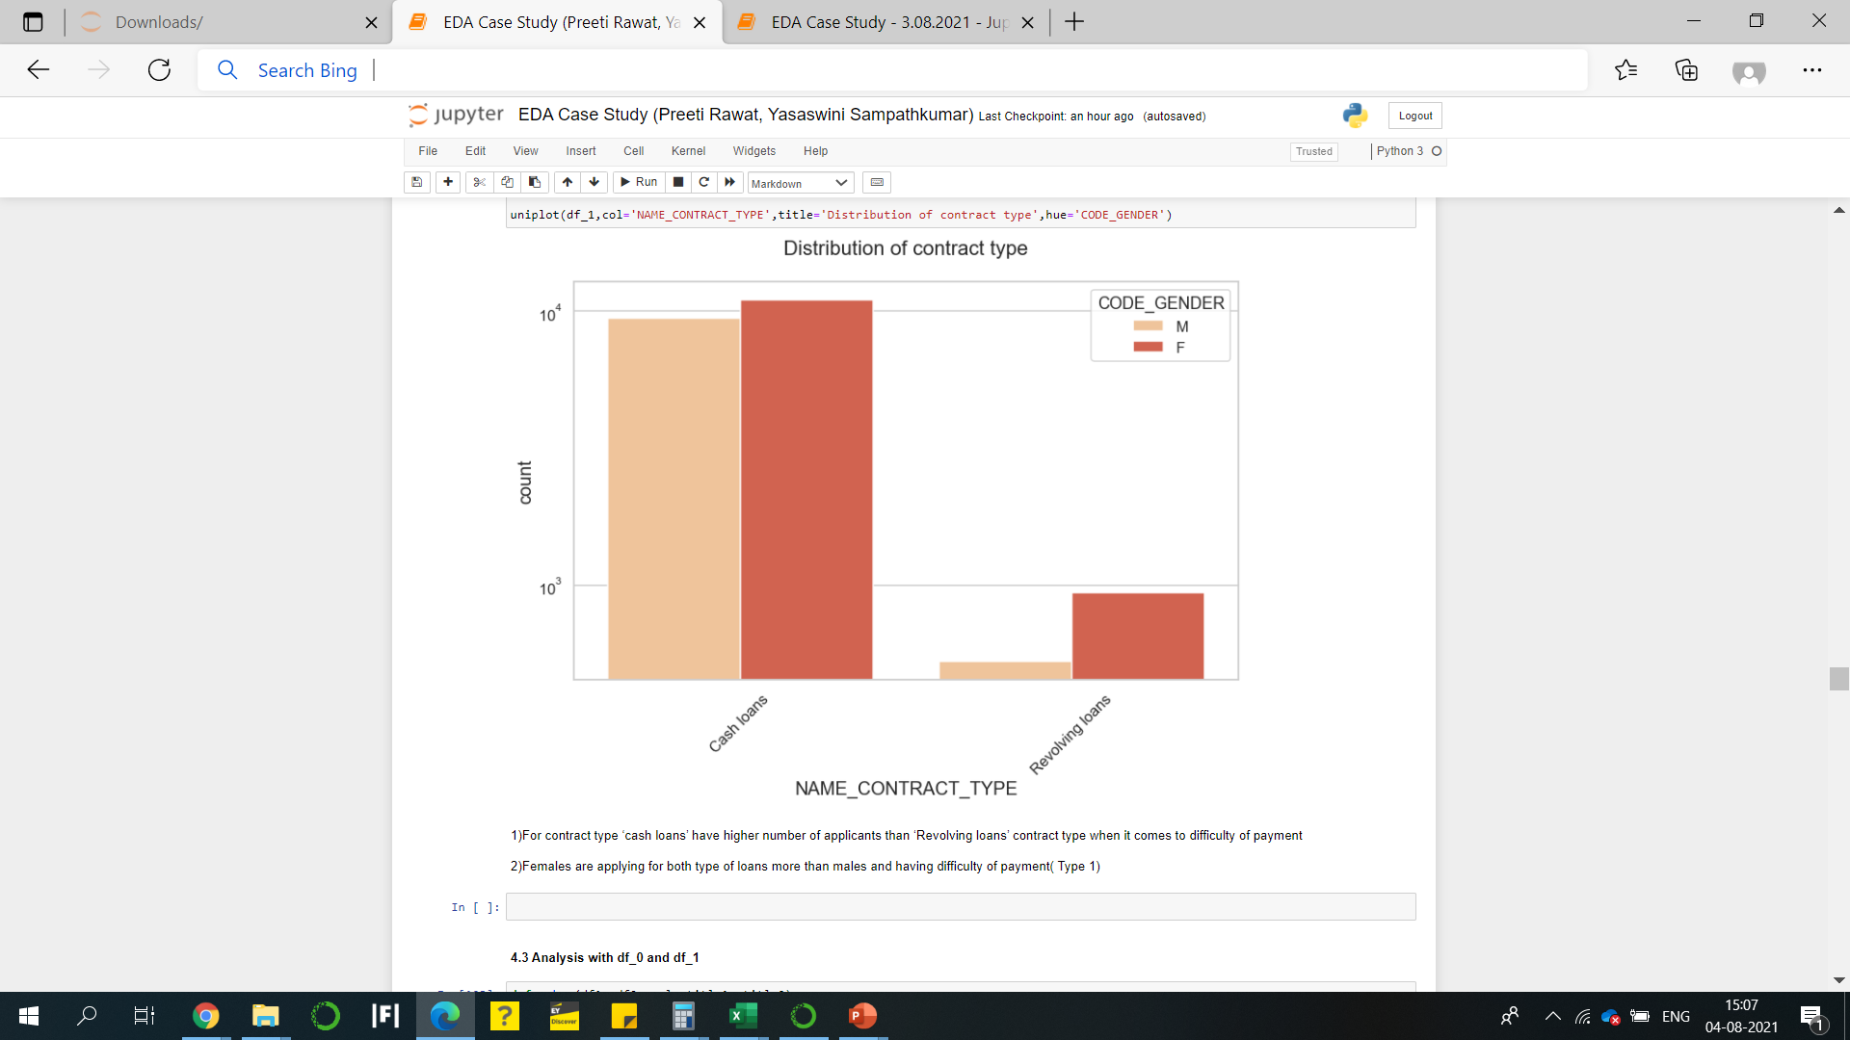
Distribution of Contract Type with respect to gender (T1)
For contract type ‘cash loans’ have higher number of applicants than ‘Revolving loans’ contract type when it comes to difficulty of payment
Females are applying for both type of loans more than males and having difficulty of payment ( Type 1)

Slide 11
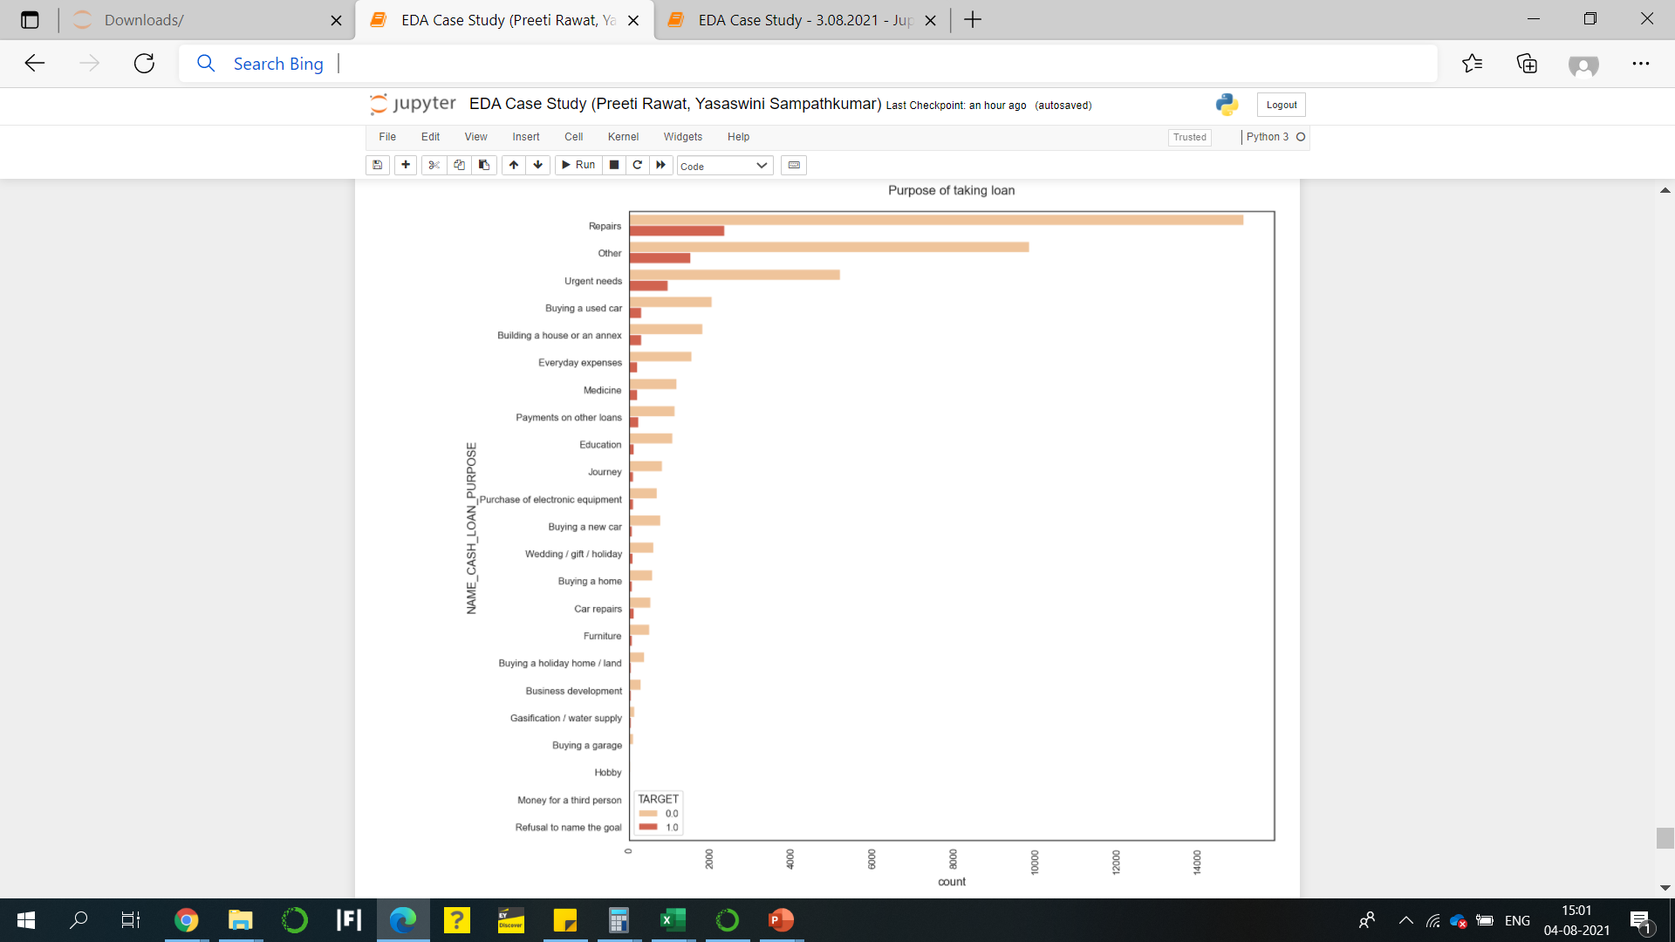
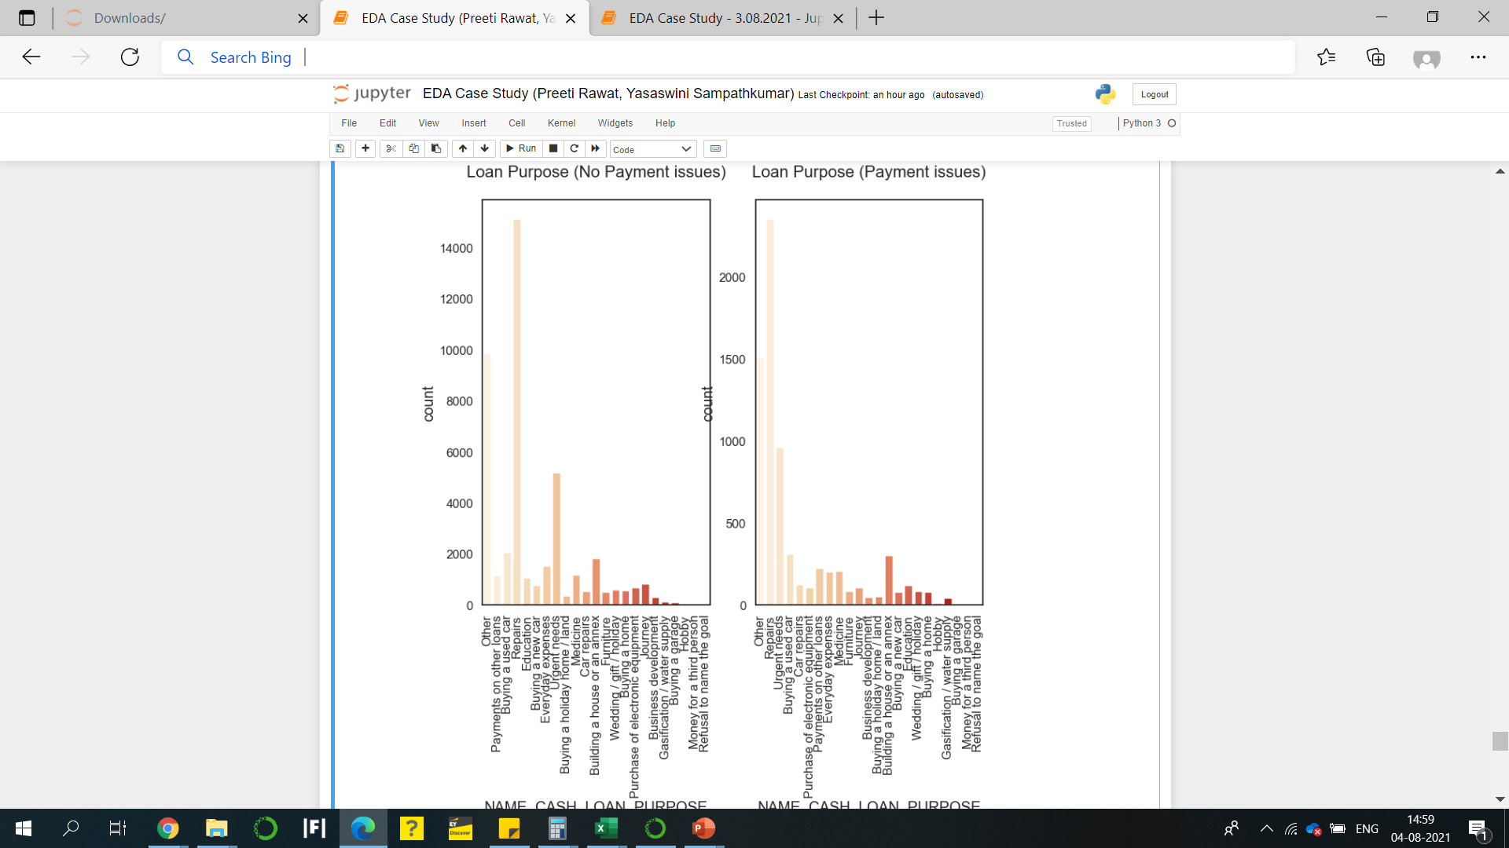
Purpose of Loan

Slide 12
A large proportion of cash loans are taken for Repairs and "Other".
Among those with payment difficulties, repairs form the greatest number.
However less than 1/7th of all loans for Repairs run into payment difficulties
The proportion of 'Urgent Needs' loans that run into payment difficulties is high
Education loans are lower risk than loans for payment on other loans
To understand driving factors, it is necessary to find the proportion of each feature that results in defaults (done in bivariate analysis)

Slide 13
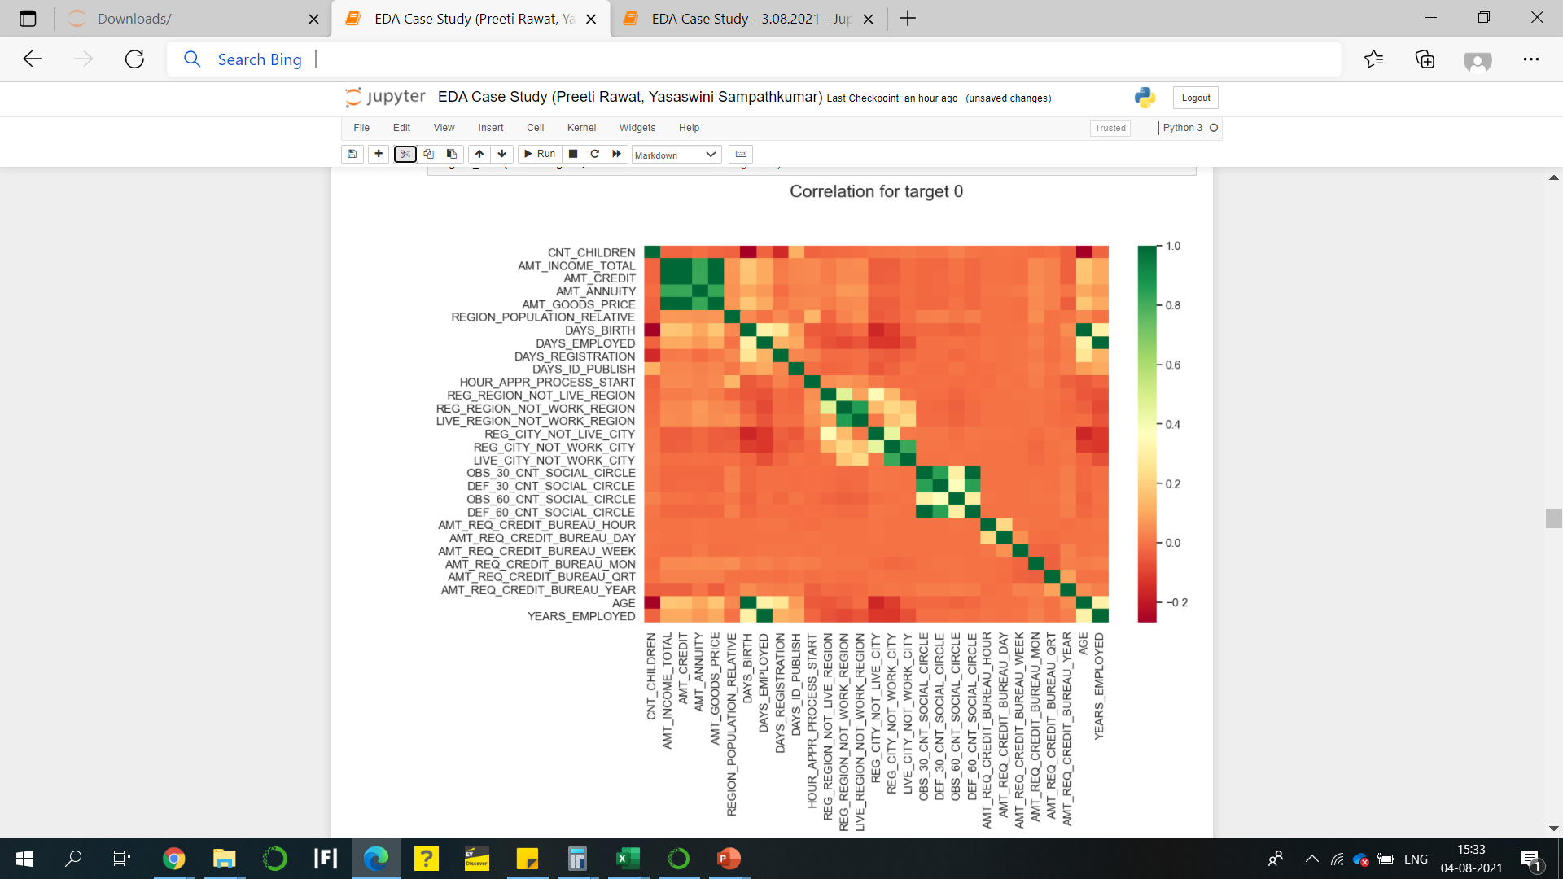
Correlation for Target 0
Observations from the heatmap on the right:
Credit amount is inversely proportional to the date of birth, which means Credit amount is higher for low age and vice-versa.
Credit amount is inversely proportional to the number of children client have, means Credit amount is higher for less children count client have and vice-versa.
Income amount is inversely proportional to the number of children client have, means more income for less children client have and vice-versa.

Slide 14
3. Bivariate and Multivariate Analysis

Slide 15
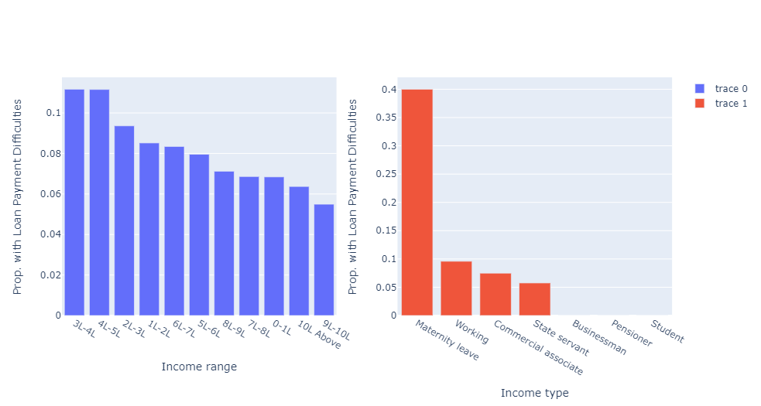
Insights – Driving Factors
From the graphs on the right:
Maternity leave is the highest proportion when it comes to income type, so it may not be fair to say women default more since in this dataset the proportion of income type from maternity leave is the highest.

Slide 16
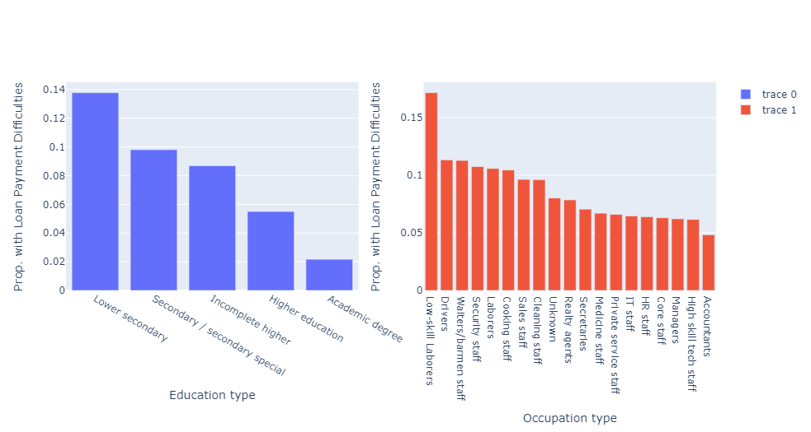

Slide 17
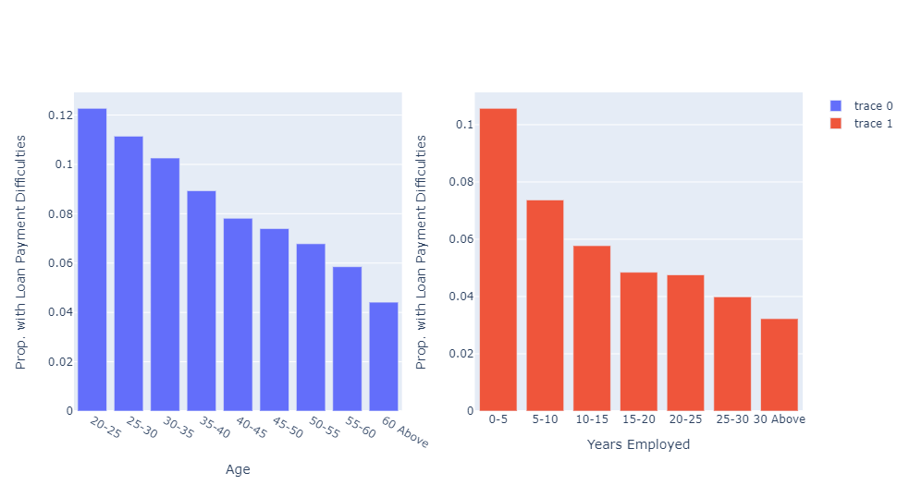
Defaults decrease as age and years of employment increase

Slide 18
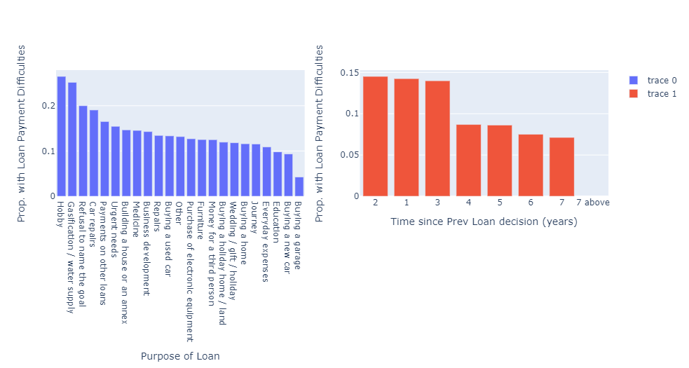
Insights – Driving Factors
- If a previous loan application was made less than 3 years ago, there is a higher likelihood of default
Loans for education, buying a new car or a garage are more likely to be repaid
Loans for hobby, car repairs, payment on other loans are high risk

Slide 19
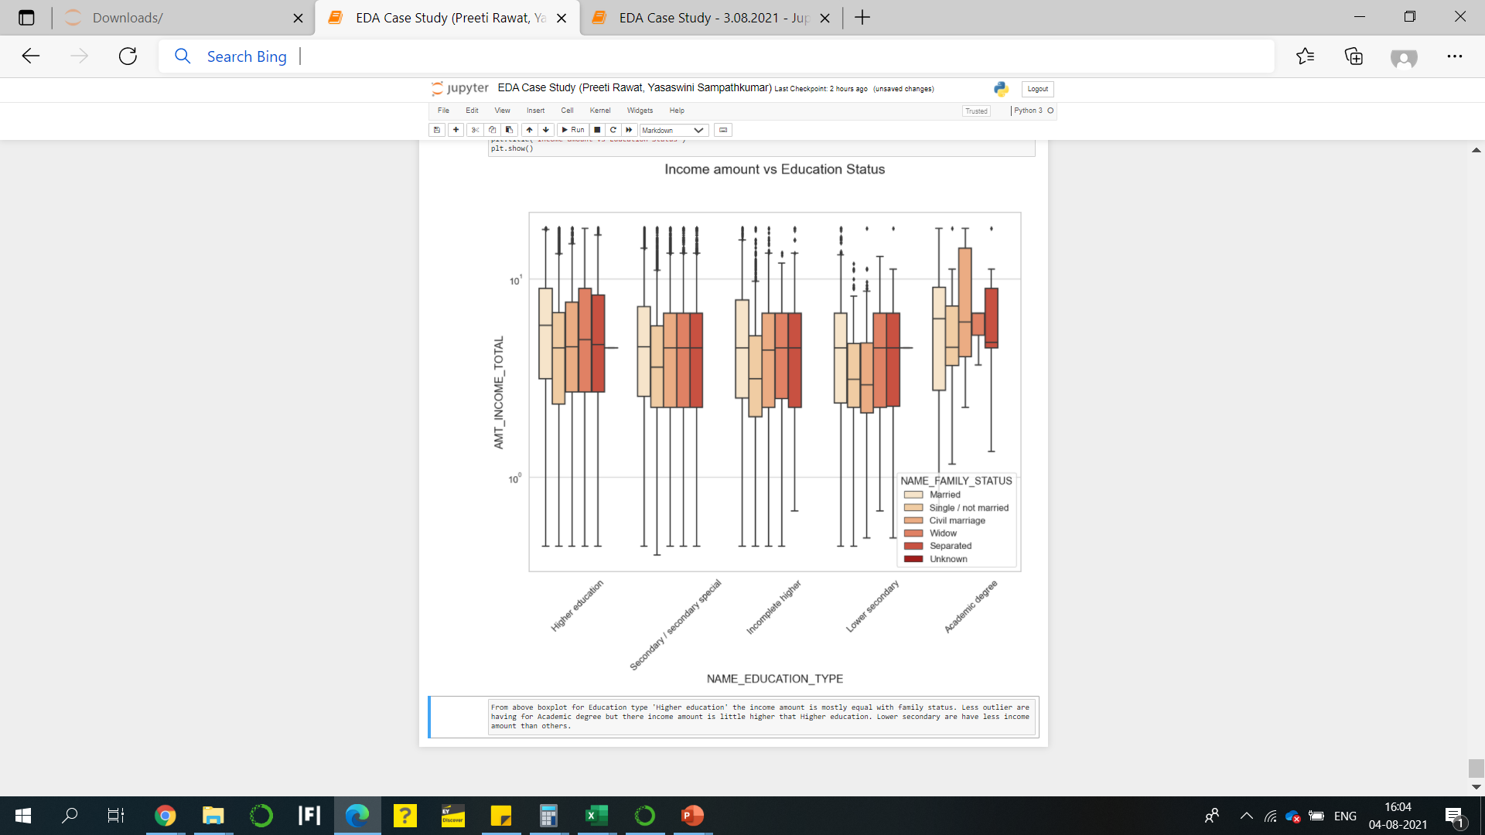
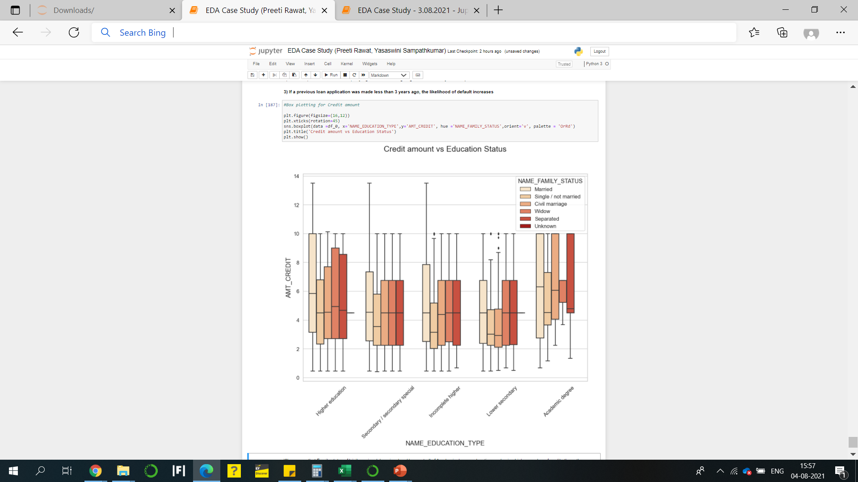
For Target 0 – no payment difficulty
We can say that Family status of 'civil marriage', 'marriage' and 'separated' of Academic degree education are having higher number of credits than others.
People with family status of 'married' have higher outliers across all education status

Slide 20
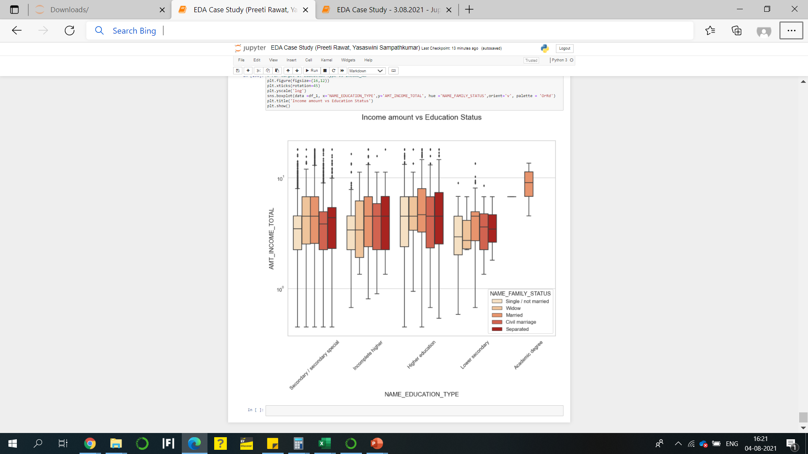
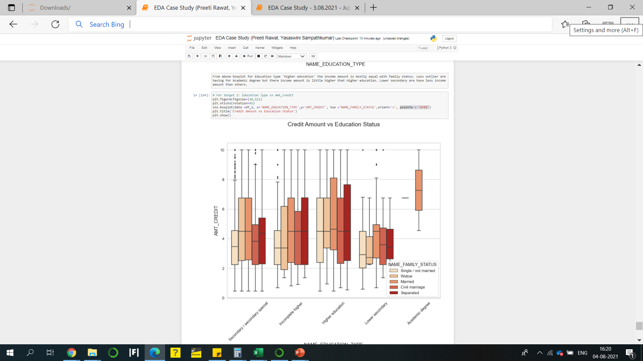
For Target 1 – with payment difficulty
We can say people with Lower secondary education status have low income.
People with education status secondary, incomplete higher and higher education have a lot of outliers

Slide 21
Conclusion & Recommended Actions
The ideal candidate for a loan:
Age >40 years
Employed for more than 10 years
Income range above 6 lakhs
Has had higher education and is working in a high-skill industry
Is taking a loan for an long-term goal - education, purchasing a garage

Slide 22
Insights – Recommended Actions
High risk candidates for loans
Age between 20 and 35 years
Recently started employment
Income range 3-5 lakhs
Secondary or higher secondary school education and working as a labourer
Purpose of loan is not divulged, or is for short-term benefit, such as funding a hobby, repaying a different loan or for repairs

